Slide 1

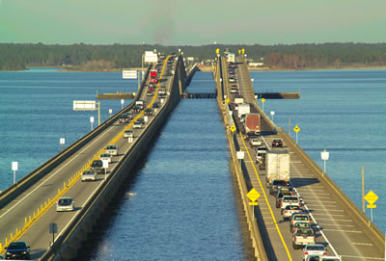
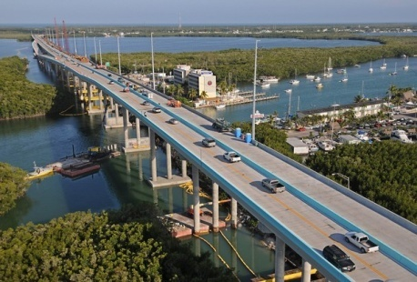




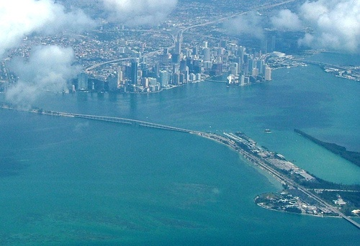
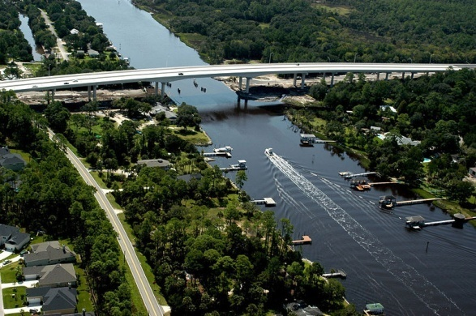


FDOT Bridge Monitoring
During Severe Weather Events

Slide 2
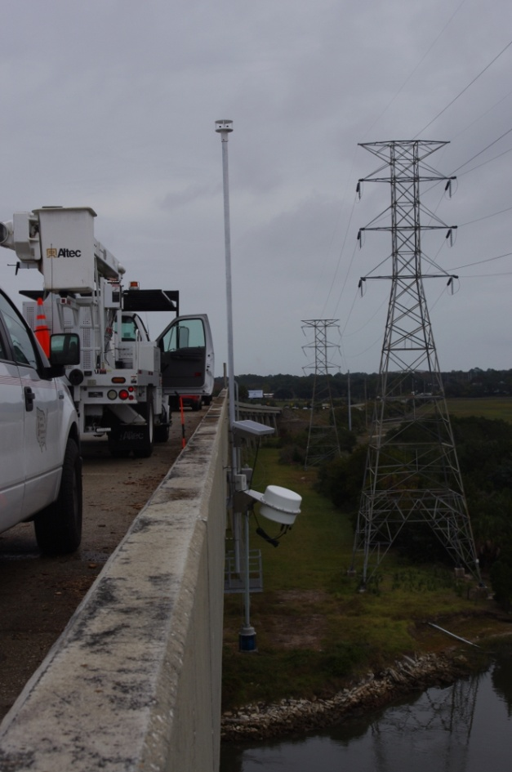
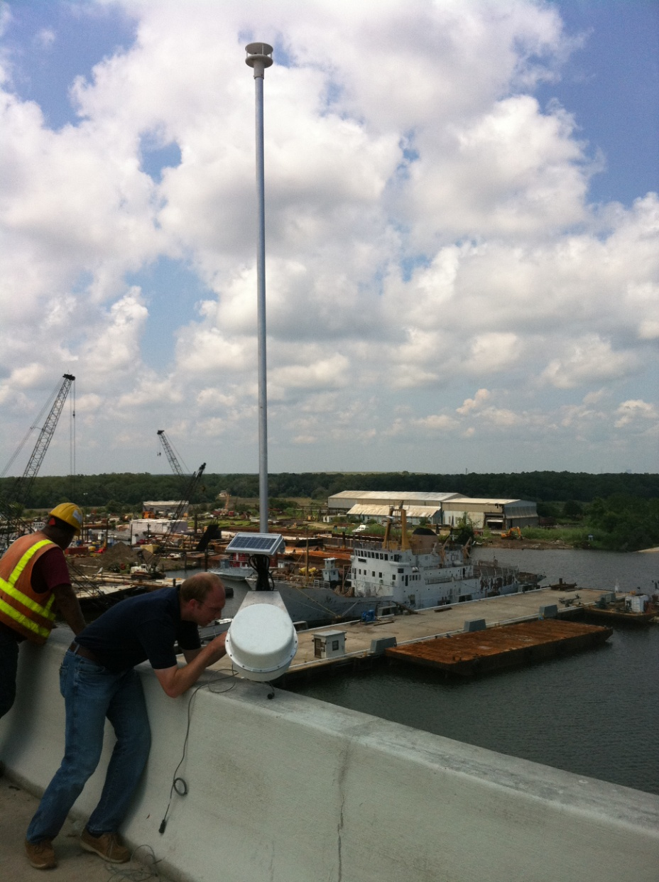
22 Bridge Installations So Far

Slide 3
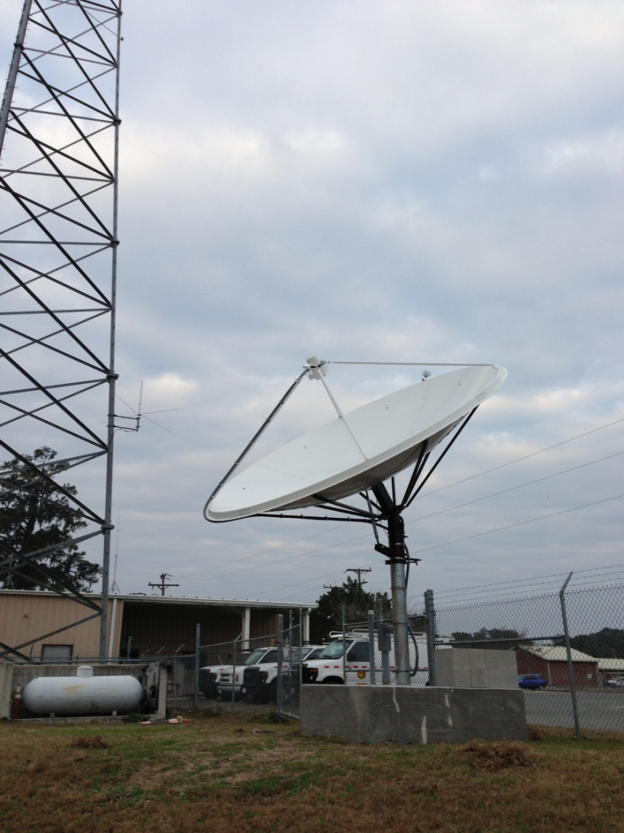
Primary FDOT Earth Station
Lake City, Florida
Alternate FDOT Earth Station
In Tallahassee Florida at the
FDOT Traffic Engineering Research Lab

Slide 4
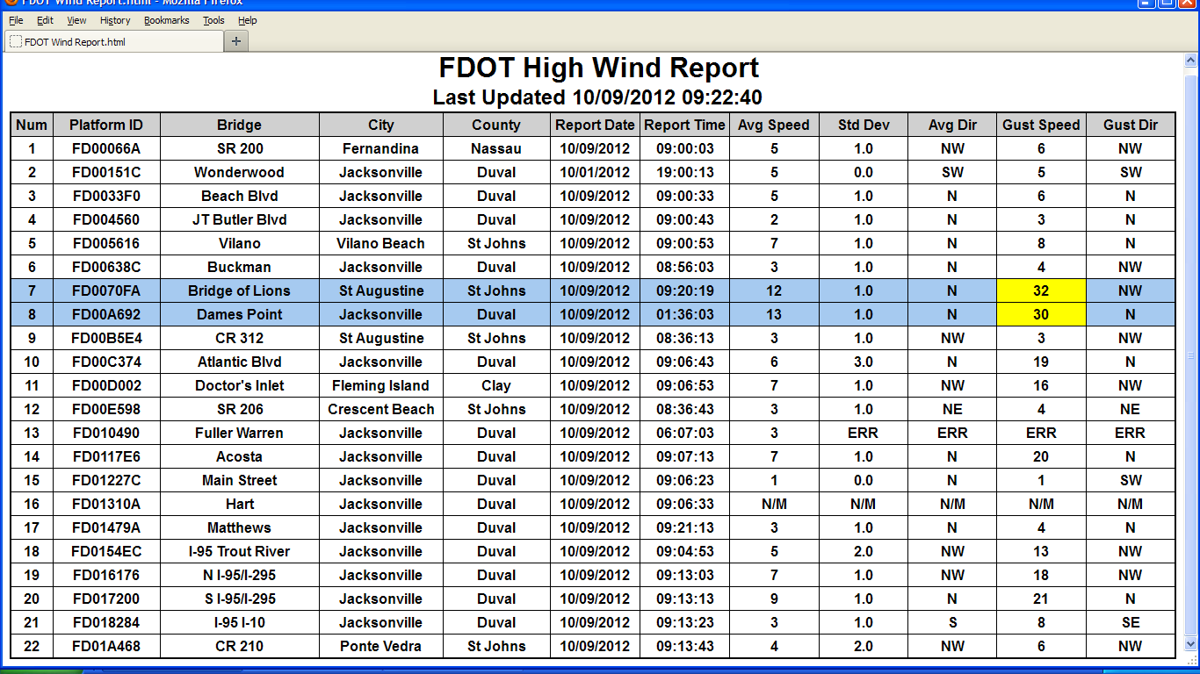
Wind Speed Data Website

Slide 5

Advanced Signal Processing:
Packet Communications
Message Optimization
Research and NOAA DCS
Brian Kopp, Ph.D.
University of North Florida

Slide 6
Packet Communications
Message Optimization
Traditional packet design typically starts with an acquisition sequence, followed by a unique word to provide packet frame sync., clock sync, etc.
Useful data then follows this “overhead”
For small packets this can mean a significant amount of time is spent transmitting unused information.
This wastes time, and energy.

Slide 7
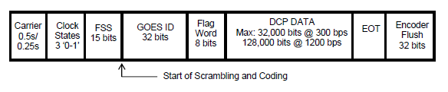
Packet Communications
Message Optimization
The DCS packet as an example:
  Carrier and Frame Sync is 0.56 seconds for 300bps
  For a short message of a few seconds this overhead is significant.

Slide 8
Packet Communications
Message Optimization
For several years preamble-less packet structures have been used to improve small packet efficiency and throughput.
More sophisticated receiver design was necessary to support preamble-less packets.
The industry is continuing to leverage improvements in receiver design to push the envelope on small packet communications, but the reasons are changing……

Slide 9
Packet Communications
Message Optimization
Power Efficiency is a new driver in Packet Comms Message Optimization
  Industries including Civil Engineering, Medicine, and Defense are using more power efficient communications
  Smartphone and Tablet markets are also pushing the power efficiency envelope and this is impacting communications as well
  Energy Harvesting and extreme low power operation is the new normal on the frontier of efficient communications

Slide 10
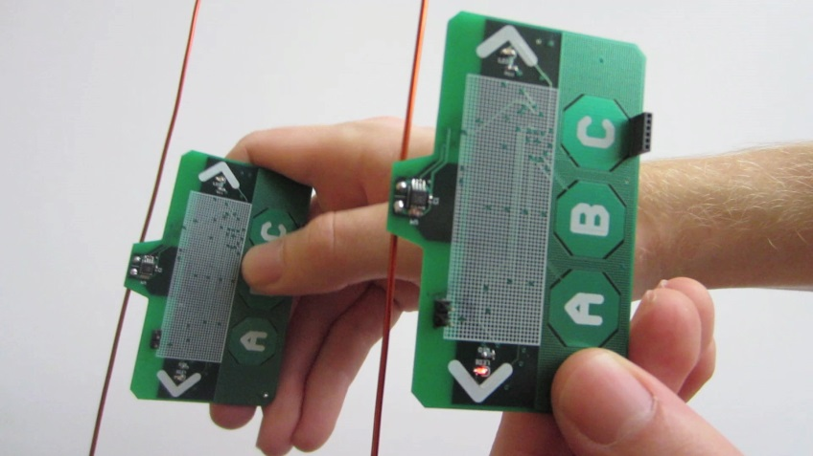
Packet Communications
Message Optimization
University of Washington Research
  Ambient Backscatter Communications
  Energy Harvesting
  No Battery
University of North Florida
  Micro-Electro-Mechanical Systems (MEMS) subcutaneous seizure detection research
    Embedded low power sensor and transmitter

Slide 11
Packet Communications
Message Optimization
What does all this mean for NOAA DCS?
  The next generation DCS packet communications could include a highly efficient optional message format.
    More efficient bandwidth and timeslot utilization
    More efficient transmitter power management
    Future proofing for a more crowded user community
  But current loading on DCS is low right?
    Yes. Current loading is just under 10%
    But NOAA is not Verizon or AT&T and NOAA infrastructure and user equipment has a much longer life cycle.
    Also, the world demand for information is not growing linearly. We now measure the world’s use of information in zetabyte where one zetabyte = one billion terabytes

Slide 12
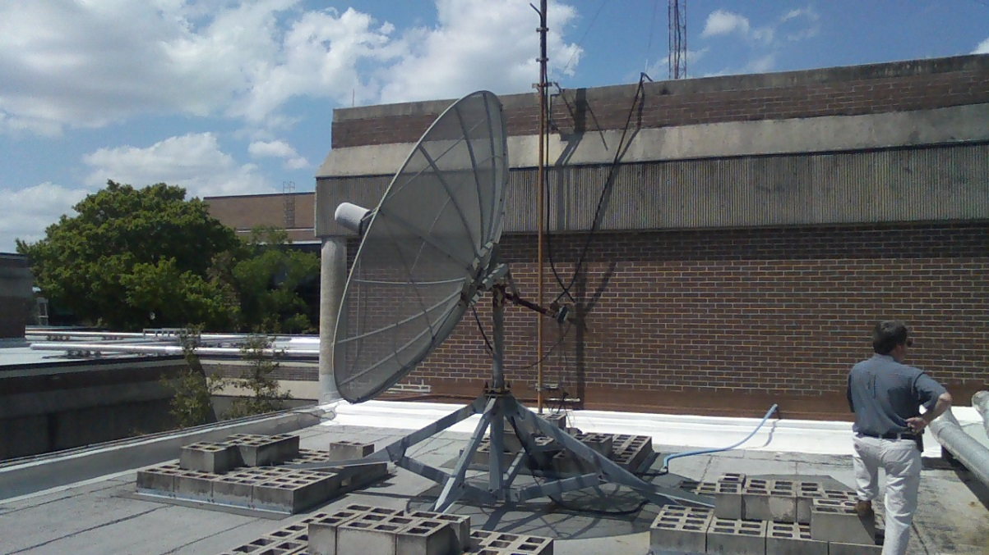
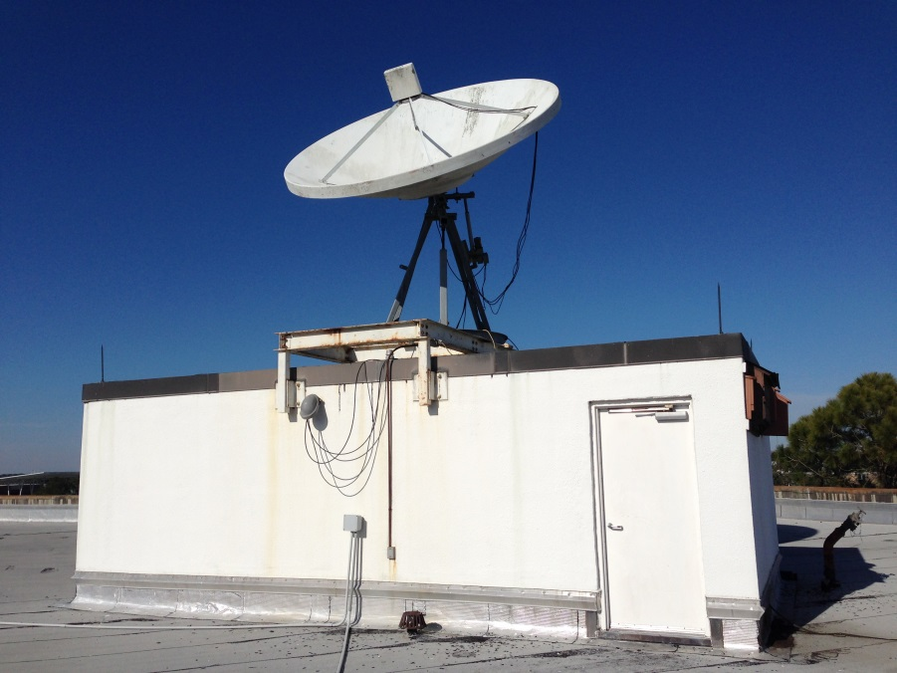
Packet Communications
Message Optimization
New Telecommunications Advanced Research Program at UNF
  Efficient Packet Communications Research
  Satellite Communications Research

Slide 13
Packet Communications
Message Optimization
Additional Research Ideas that may benefit NOAA DCS
  If you are going to reengineer a packet message format for sat comm……Consider addressing next generation challenges such as:
    Embedding features that will support noise characterization and link performance monitoring
    Geo-locating transmitters
    Developing best-practices receiver design recommendations to give stakeholders a fast-track to building compliant devices
  Leverage previous standards work in the international community: ITU/Intetsat/etc.

